Slide 1
Meet my friend...
This is when he is not working...

Slide 2
Well, as it is evident, he is not feeling alright.

Slide 3
Oh, my god now you are coughing....
Well, Sam I think you should be getting home...

Slide 4
Yes, yes, I know how you feelin' so run away now and get checked up...

Slide 5
Good better get going fast or you gonna spray everywhere

Slide 6
Yeah yeah take the lift...infect more you moron

Slide 7
Now you are pressing all the buttons, what kind of an idiot are you, really???

Slide 8
no, no not that fast
I know you are worried...

Slide 9
Let's alarm others, if we can at the office to not take the lift

Slide 10
There you go....

Slide 11
For god's sake use your pen or keys...please

Slide 12
OH MY GOD , now you are touching your face
God, why did you send these idiots to earth???

Slide 13
Ok! I see now you are coughing

Slide 14
even you are coughing

Slide 15
Pheobe buffay from the friends, is that the coughing episode???

Slide 16
Mr Bean you don't even work at that office??

Slide 17
Well, he is going to be dead soon.

Slide 18
It's all because of you

Slide 19


What is the situation and need??
A recent review of the survival of human coronaviruses on surfaces found large variability, ranging from 2 hours to 9 days. The survival time depends on several factors, including the type of surface, temperature, relative humidity and specific strain of the virus.
Source : WHO

Slide 20
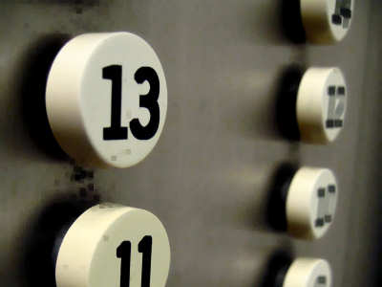
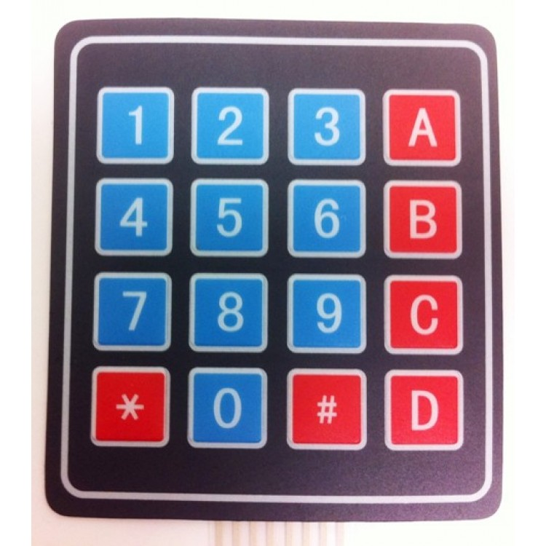
TOUCHLESS KEYPADS FOR UTILITIES TO CURB SPREAD OF CORONAVIRUS
Aim Is To Build Touchless Keypads For Data Entry At Places Of Work That React To The Presence Of A Pointer Such As INDEX Finger

Slide 21
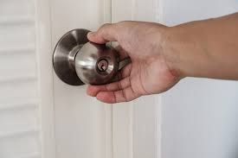
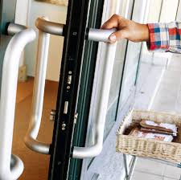
What is the situation and need??
Infected surfaces are much more difficult to identify and separate out than infected individuals
And Hence, more dangerous

Slide 22
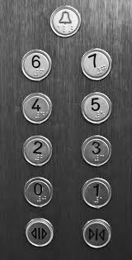
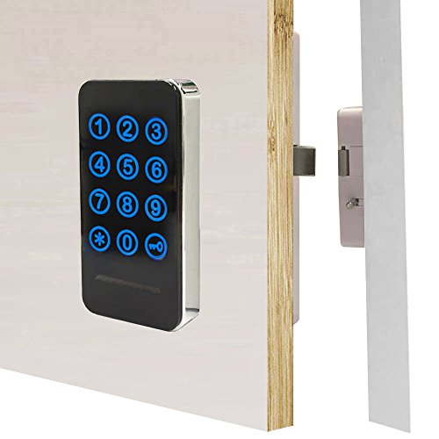
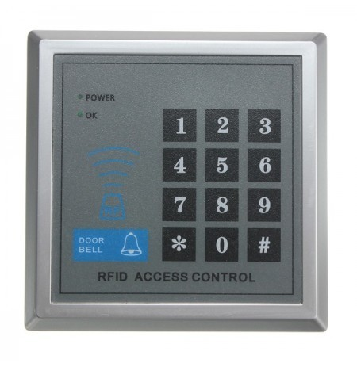
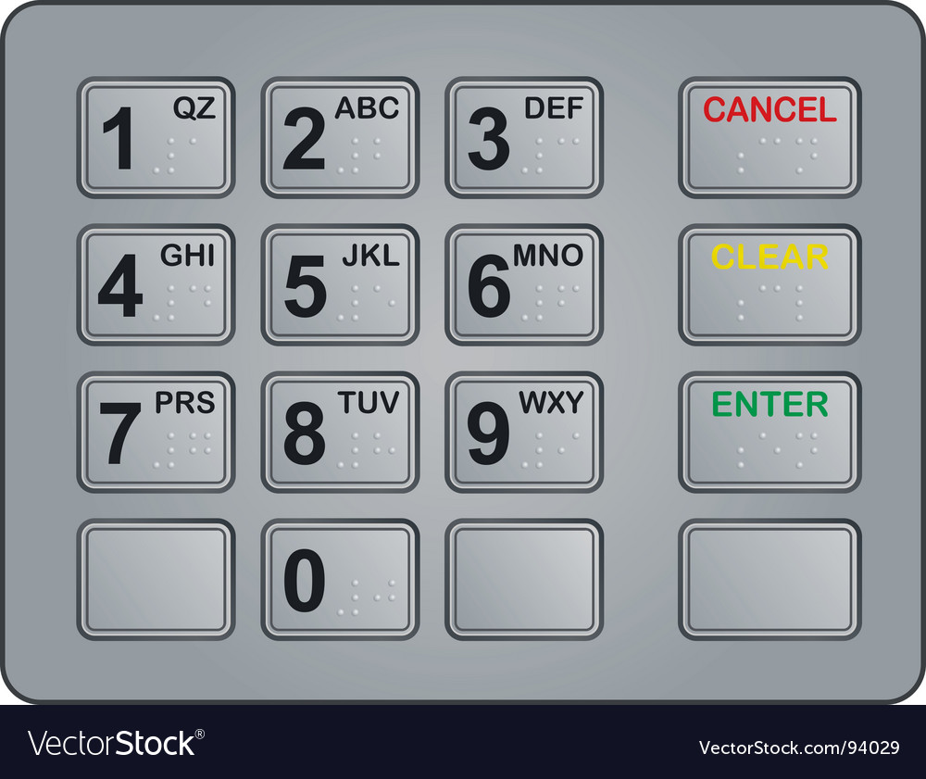
So, here is the AIM of our project
The aim is to build presence activated keypads that eliminate the need of touch by using a matrix of obstacle sensors meant for small range, for data entry and are safer and more secure.

Slide 23
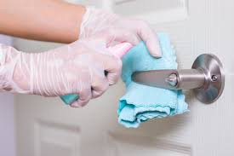
Our idea is aimed at reducing physical contact with those surfaces as much as possible.
What is our idea ???

Slide 24
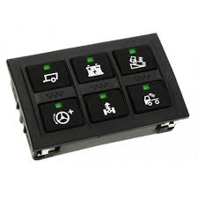
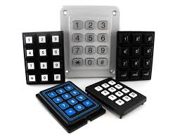
At offices, lifts, protected doors and other such places there are surfaces where there is a frequent need of data entry.
What is our idea ???

Slide 25
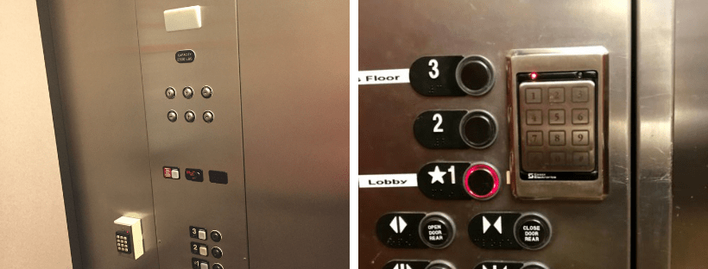
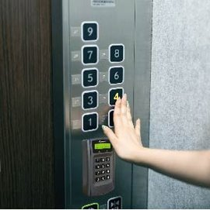
Such surfaces are constantly touched by everyone and can hold viruses for days to come if not sanitized properly.
What is our idea ???

Slide 26
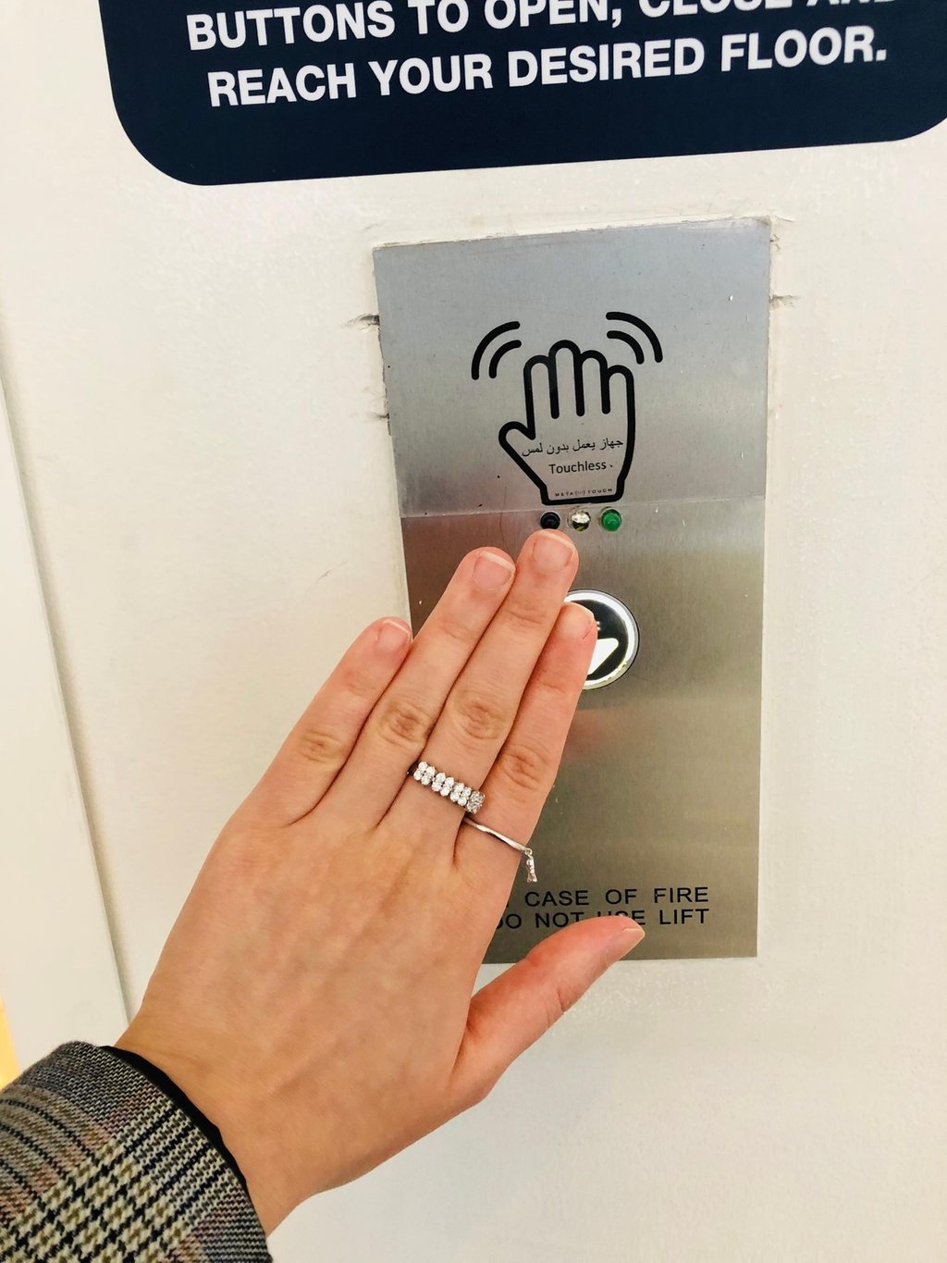
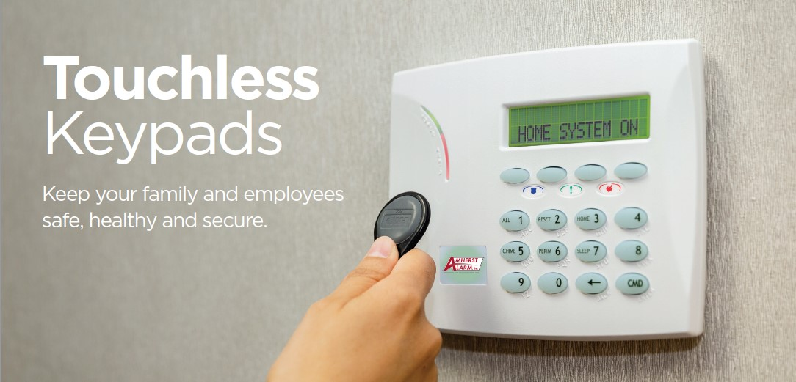
So, why don't we just eliminate the need of touch by making those surfaces presence sensitive rather than touch sensitive...?
What is our idea ???

Slide 27
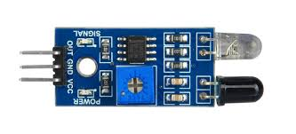
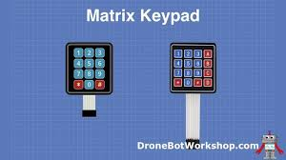
The keypad consists of a matrix of low range obstacle sensors that are activated when a pointer like object such as your index finger is brought close to the surface of the sensor.
So, How will it work???

Slide 28
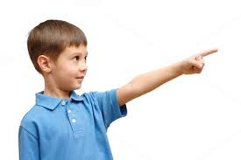
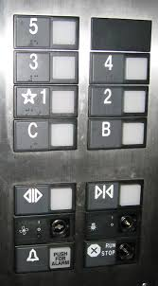
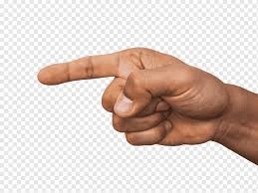
The user is supposed to bring his index finger or any suitable pointer such as vehicle key, pen, pencil etc. close to the sensor window.
So, How will it work???

Slide 29
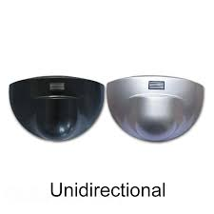
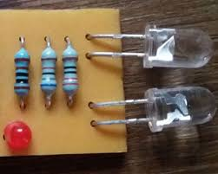
The design of the window would be small and in such a way that the transmitter is forced to receive the reflected light from only one direction.
So, How will it work???

Slide 30
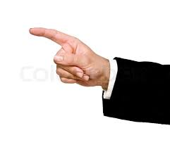
Similar sensors would be placed under each key and would activate upon close presence individually.
So, How will it work???

Slide 31
Now before you start doing this yourself

Slide 33
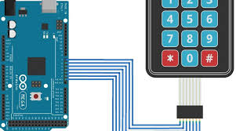
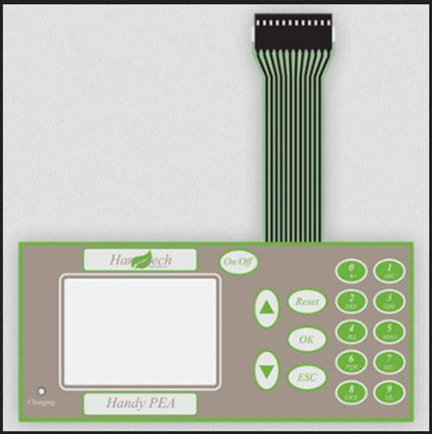
These keypresses would then generate a particular code and that code will be analyzed by a small microcontroller
So, How will it work???

Slide 34
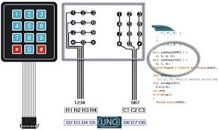
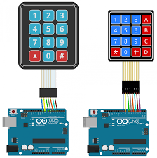
The microcontroller will generate appropriate responses based on the code and the suitable action will be taken depending on the system it is meant for.
So, How will it work???

Slide 35
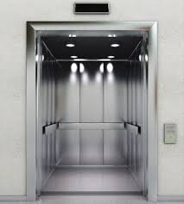
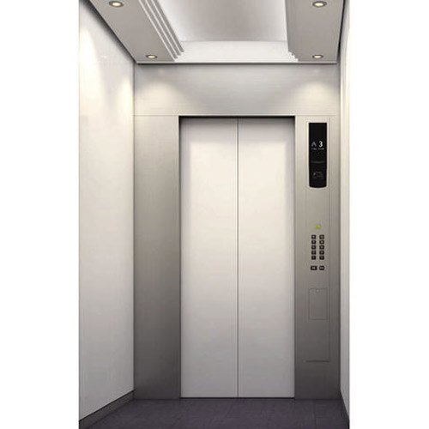
Intended applications and implementations
LIFTS
Lifts are among the most visited avenues in a multistorey office building.
Many of them have lift operators for you that press the floor button for you
But this is not the case everywhere.

Slide 36
Intended applications and implementations
LIFTS
We can put our touchless keypads there and then the user can simply hover his/her finger on the intended floor label surface and that floor will be selected.

Slide 37
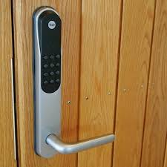
Intended applications and implementations
DOOR PASSWORDS
Entering passwords before entering a secure room is a very popular security solution but requires the key to be entered by touching the keypad surface.
Many individuals may have access to the rooms and thus they can also turn out to be hives for viruses.

Slide 38
Intended applications and implementations
DOOR PASSWORDS
Putting the touchless keypad in place of the traditional one would not only save your finger smudges from getting around the keys but even save you from contracting the virus

Slide 39
Other applications discussed in brief
The beauty of this type of device is that it can be implemented in all types of keypads which have limited type of data entry.
They can be used for replacing simple switches, like doorbells, power on and off etc
They are just a different category of keypads and thus can be used ot replace all existing keypads wherever necessary and suitable.

Slide 40


Every idea until implemented successfully is just a fickle of the mind's imagination.
Budget and expenditure

Slide 41



Budget and expenditure
The touchless keypad will require some research before a successful response rate can be guaranteed.​

Slide 42
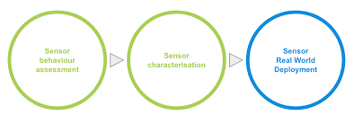
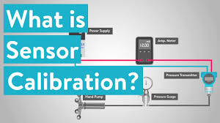
Budget and expenditure
We will have to check for appropriate proximity sensors that have suitable range, high sensitivity and low false rate.

Slide 43



This will require testing and experimentation and therefore we need a strong support so that we can stay motivated and convert that idea into something useful that benefits the society.
Budget and expenditure

Slide 44


Budget and expenditure
we may require 5k-10k for research and once the finish product is ready it would be around 2k-3k cost.

Slide 45
Future and derived developments
Touchless biometric
This would be based on image processing and other techniques which involve pattern recognition and hence we can keep it in derived developments.

Slide 46
Future and derived developments
Special sensors
We can work on reducing the false rate detection by introducing specially designed sensors only for this purpose

Slide 47
THANKYOU
ANY QUESTIONS???

